Slide 1

SCSA1401
OBJECT ORIENTED ANALYSIS AND SYSTEM ENGINEERING
BY
Ms. B. KEERTHI SAMHITHA & Ms. SUJA. C. M
Assistant Professor
Department of CSE

Slide 2
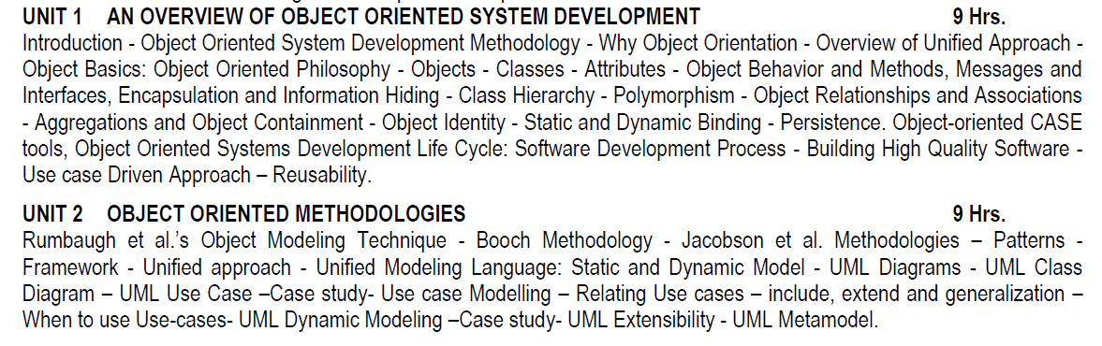
SYLLUBUS

Slide 3
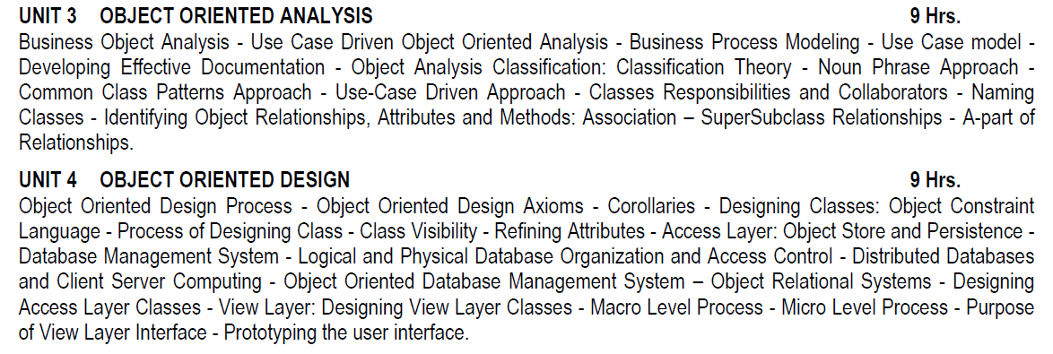
SYLLUBUS

Slide 4
SYLLUBUS

Slide 5
COURSE OUTCOMES
CO | DESCRIPTION
CO 1 | Understand the basics object model for System development.
CO 2 | Understand the object Oriented Methodologies
CO 3 | Express software design with UML diagrams.
CO 4 | Understand the concept of Relationships.
CO 5 | Design software applications using OO concepts
CO 6 | Understand the various testing methodologies for OO software.

Slide 6
UNIT 1
AN OVERVIEW OF OBJECT ORIENTED SYSTEM DEVELOPMENT

Slide 7
WHAT IS OBJECT ORIENTATION
An "object" is anything to which a concept applies, in our awareness
Things drawn from the problem domain or solution space.
E.g., a living person in the problem domain, a software component in the solution space

Slide 8
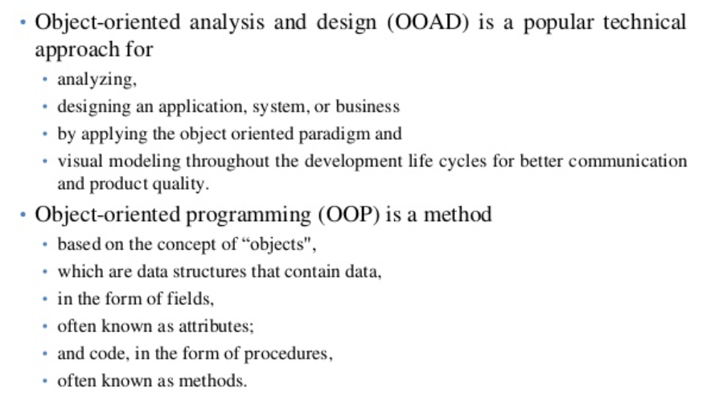

Slide 9
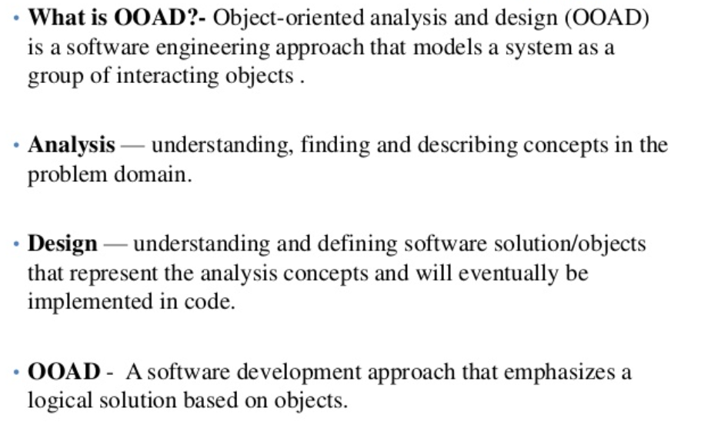

Slide 10
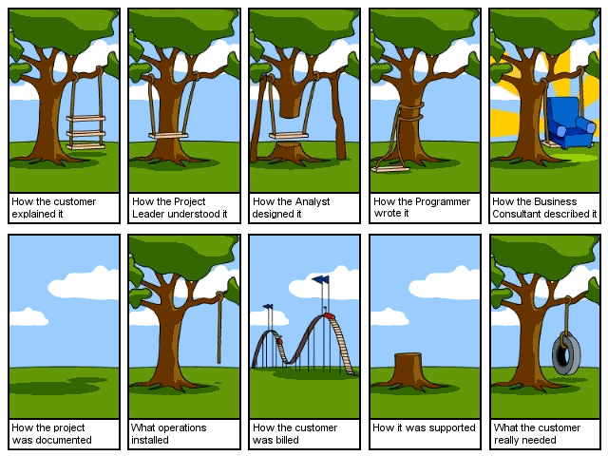

Slide 11
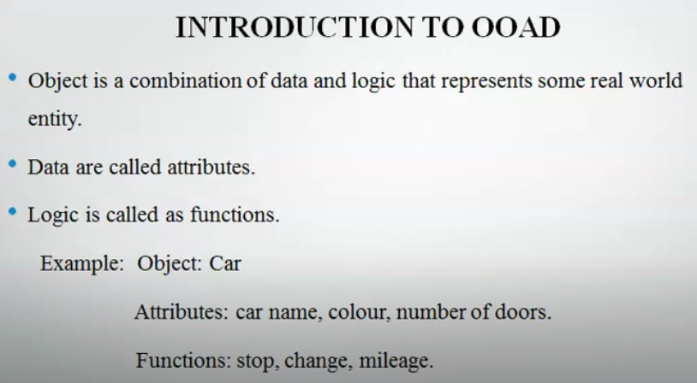
INTRODUCTION

Slide 12
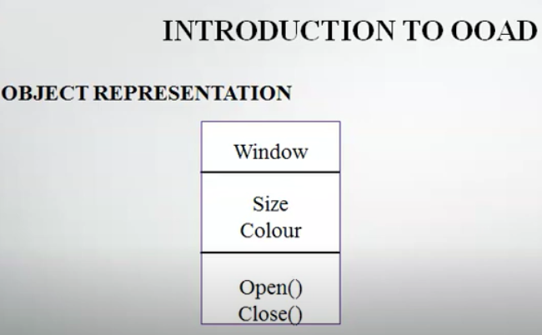

Slide 13
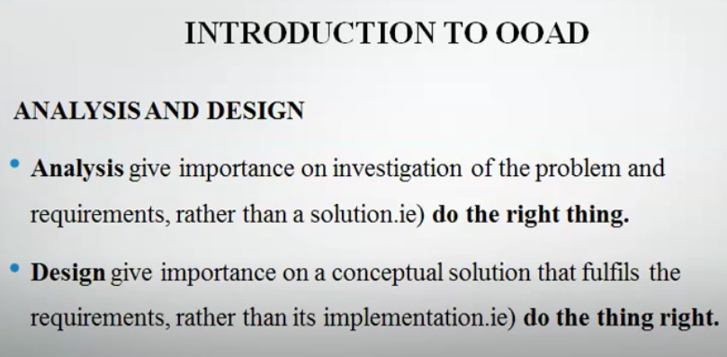

Slide 14
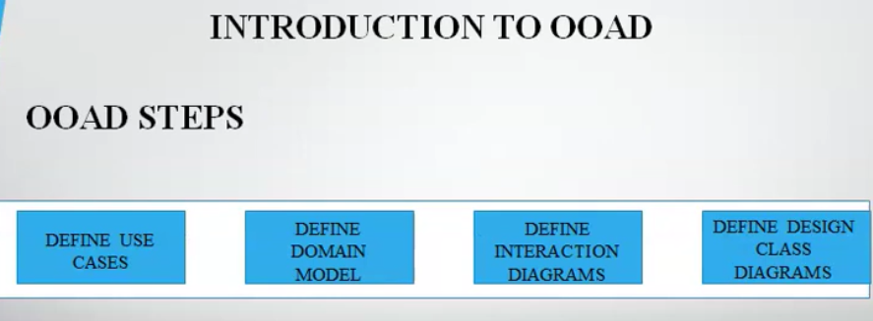

Slide 15
Object-oriented analysis
Object–Oriented Analysis (OOA) is the procedure of identifying software engineering requirements and developing software specifications in terms of a software system’s object model.
The main difference between object-oriented analysis and other forms of analysis is that in object-oriented approach, requirements are organized around objects, which integrate both data and functions.

Slide 16
Object-oriented analysis
The primary tasks in object-oriented analysis (OOA) are −
Identifying objects
Organizing the objects by creating object model diagram
Defining the internals of the objects, or object attributes
Defining the behavior of the objects, i.e., object actions
Describing how the objects interact

Slide 17
Object-Oriented Design
During object-oriented design (OOD), a developer applies implementation constraints to the conceptual model produced in object-oriented analysis.
The implementation details generally include −
Restructuring the class data (if necessary),
Implementation of methods, i.e., internal data structures and algorithms,
Implementation of control, and
Implementation of associations.

Slide 18
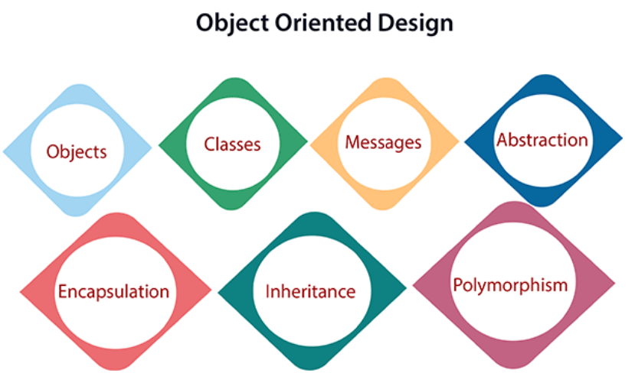

Slide 19
Object-Oriented Programming
Object-oriented programming (OOP) is a programming paradigm based upon objects (having both data and methods) that aims to incorporate the advantages of modularity and reusability.
The important features of object–oriented programming are −
Bottom–up approach in program design
Programs organized around objects, grouped in classes
Focus on data with methods to operate upon object’s data
Interaction between objects through functions
Reusability of design through creation of new classes by adding features to existing classes

Slide 20
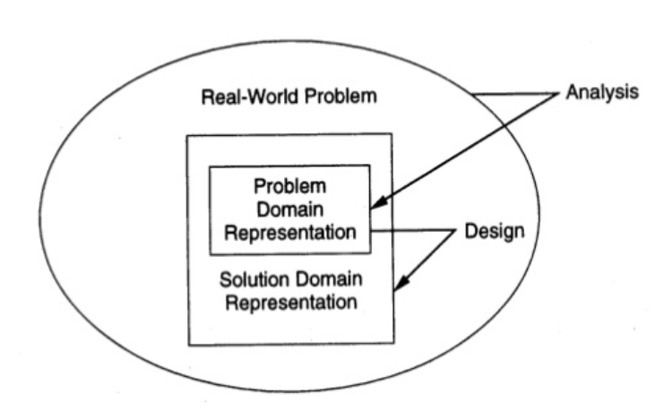
OO ANALYSIS & DESIGN

Slide 21
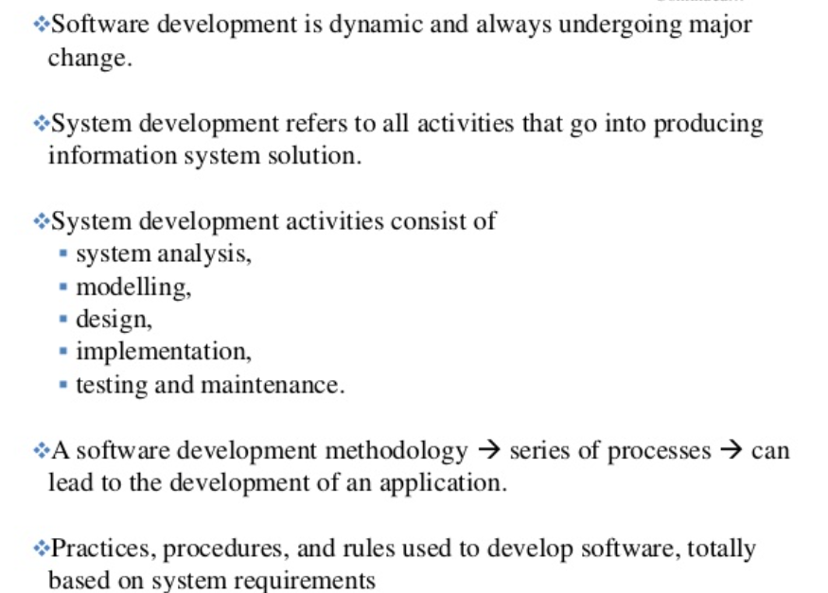
Object Oriented System Development Methodology

Slide 22
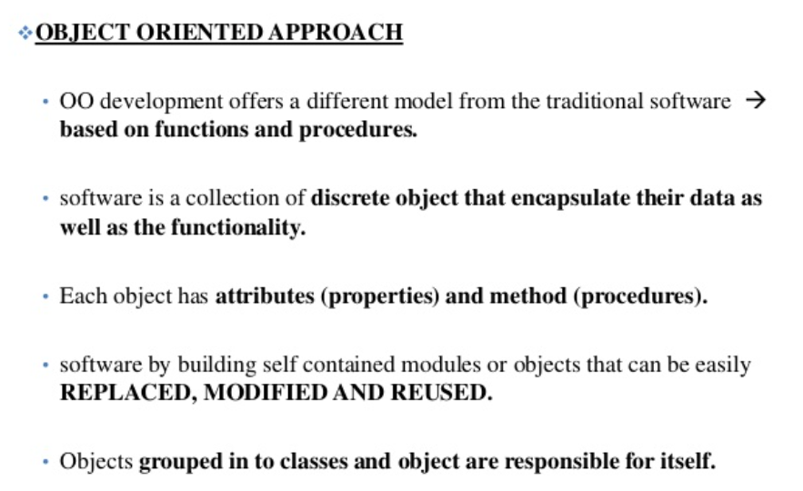

Slide 23
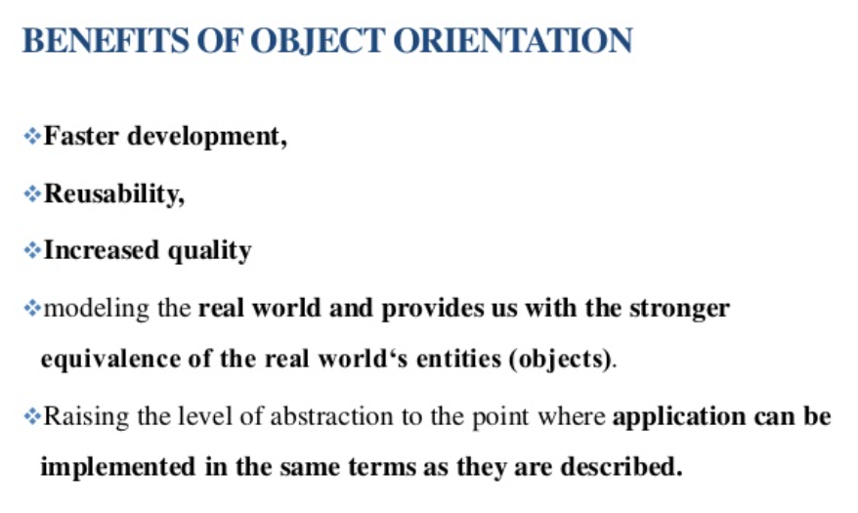

Slide 24
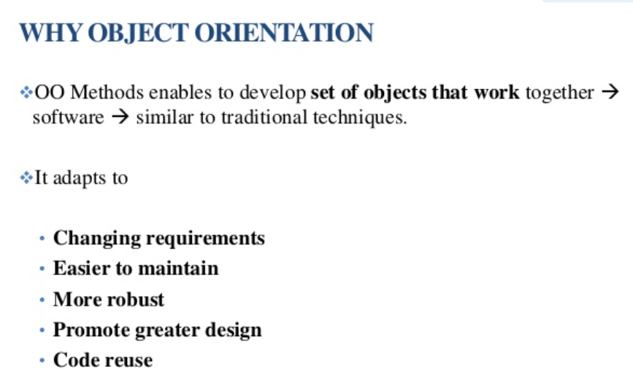

Slide 25
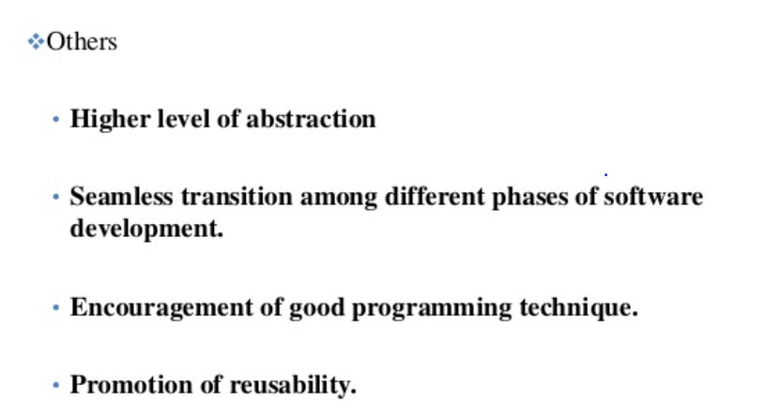
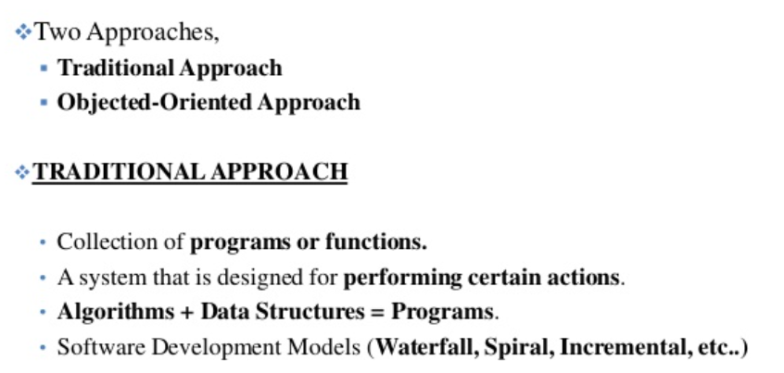

Slide 26
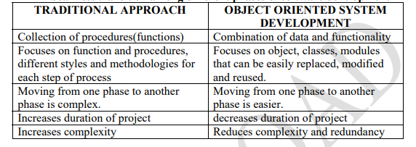
OO APPROACH

Slide 27
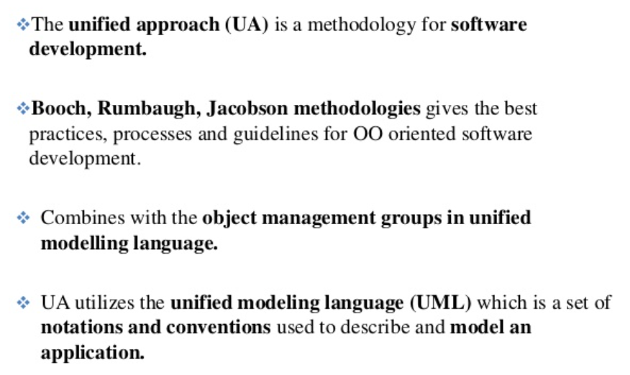
Overview of Unified Approach

Slide 28
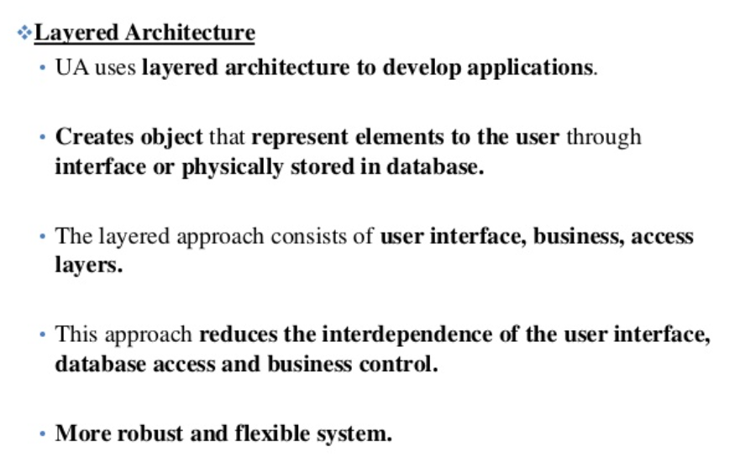
Overview of Unified Approach

Slide 29
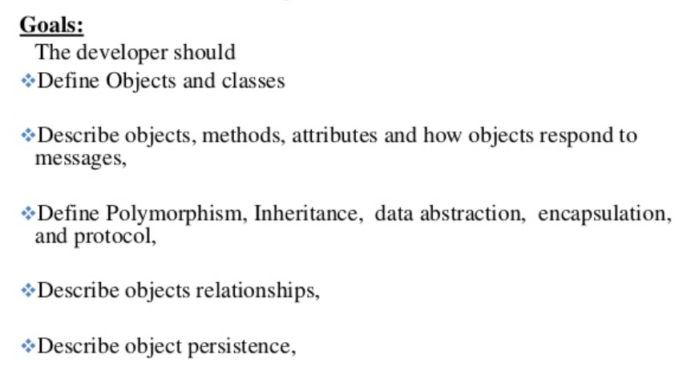
OBJECT BASICS

Slide 30
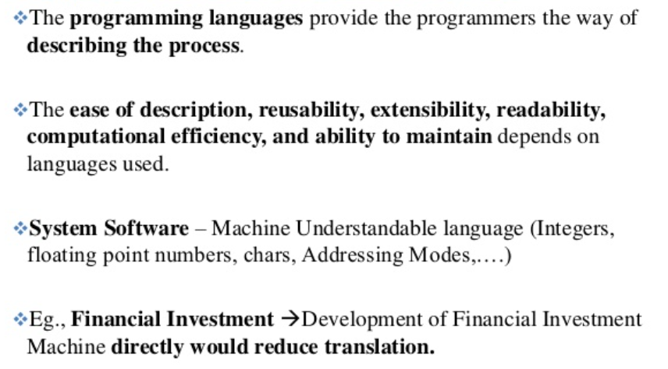
Object Oriented Philosophy

Slide 31
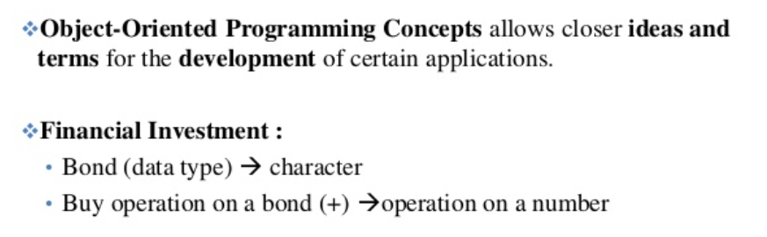
Object Oriented Philosophy

Slide 32
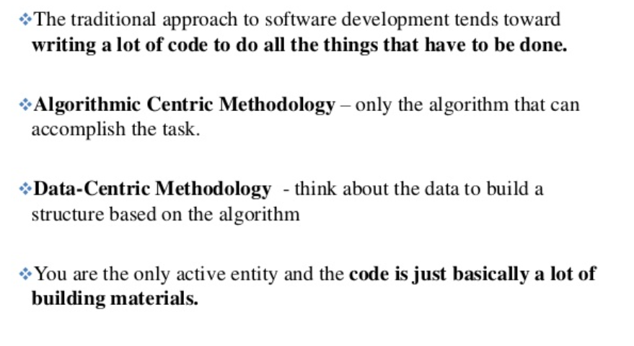
TRADITIONAL APPROACH

Slide 33
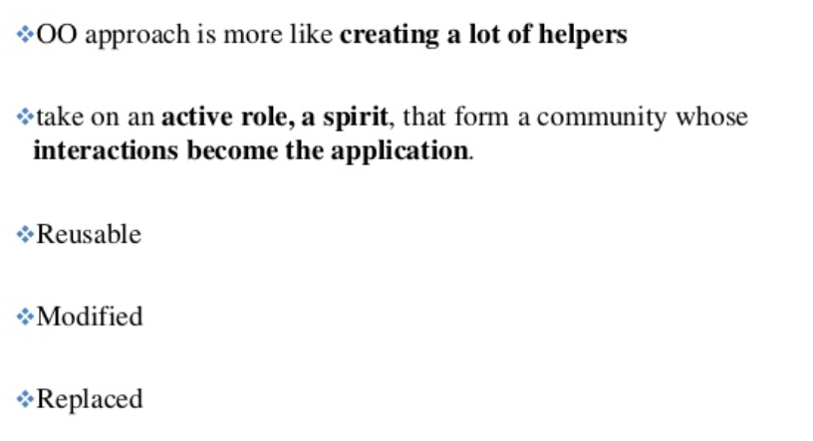
OBJECT ORIENTED APPROACH

Slide 34
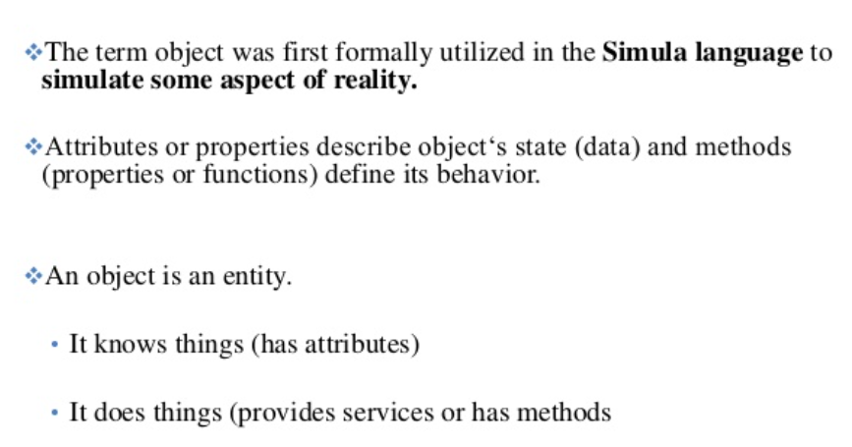
WHAT IS AN OBJECT?

Slide 35
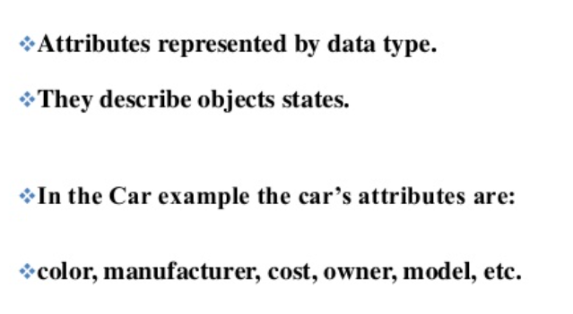
OBJECT’s ATTRIBUTES

Slide 36
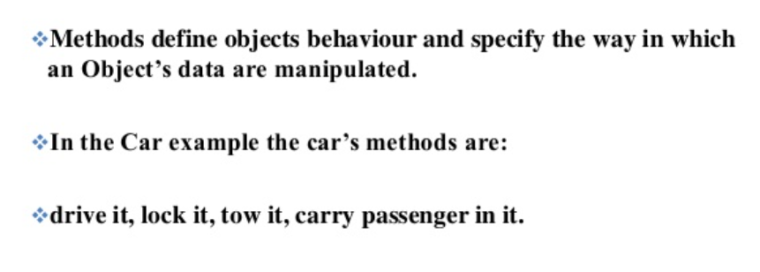
OBJECT’s METHODS

Slide 37
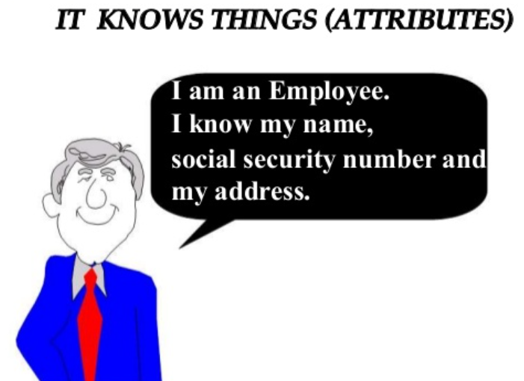
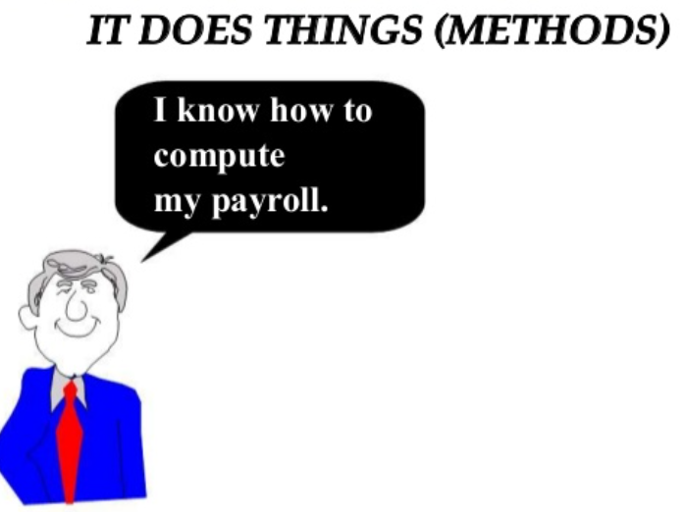
ATTRIBUTES & METHODS

Slide 38
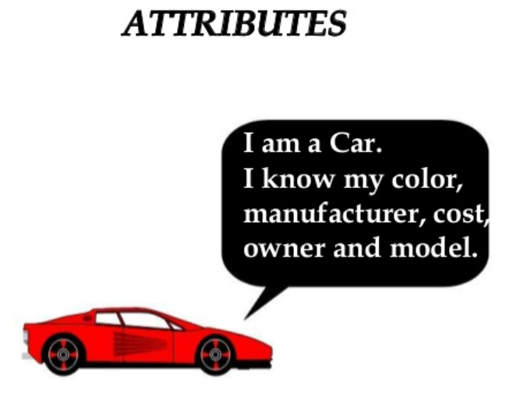
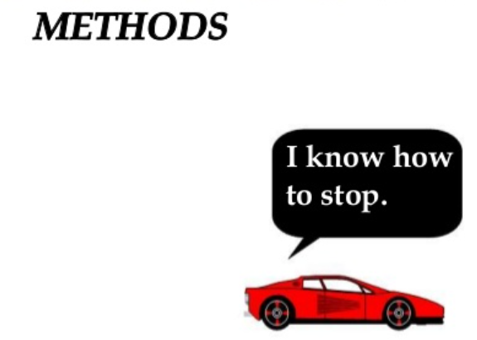
ATTRIBUTES & METHODS

Slide 39
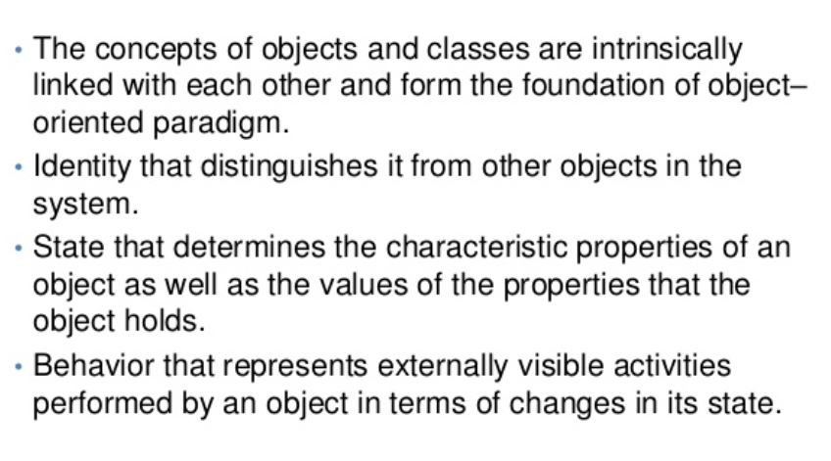
OBJECTS

Slide 40
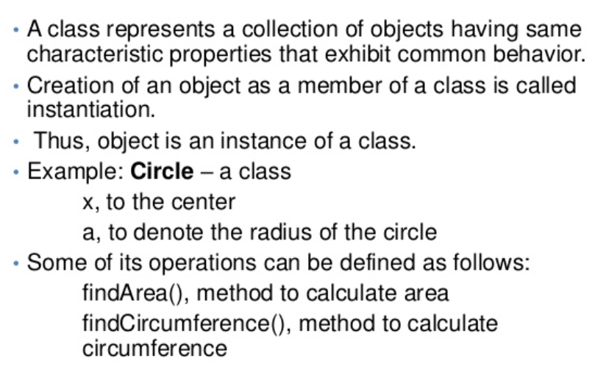
CLASS

Slide 41
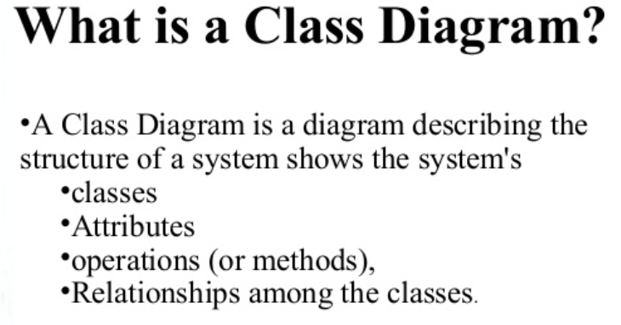
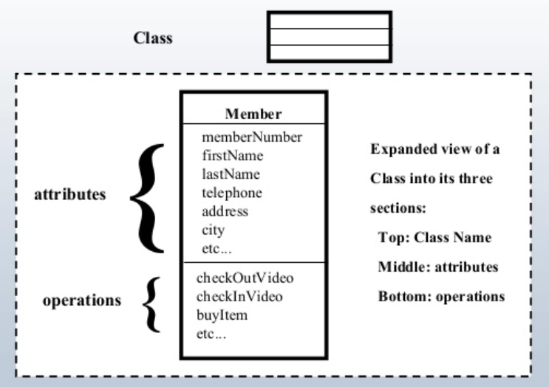

Slide 42
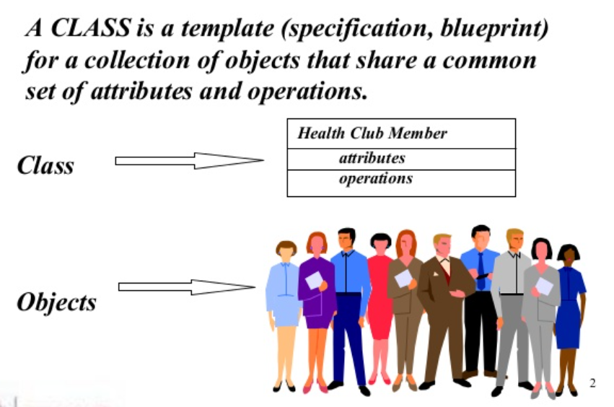
CLASS

Slide 43
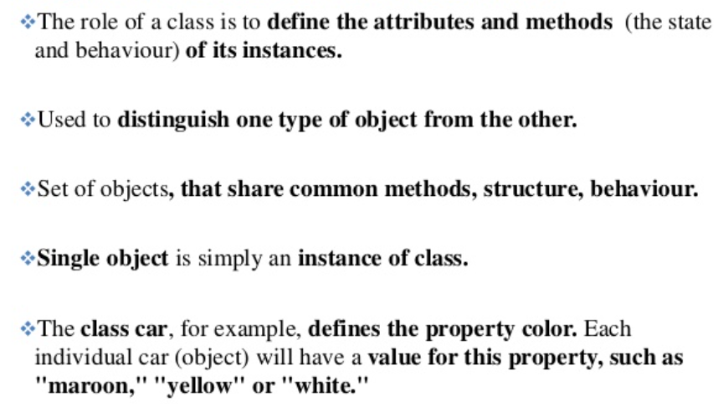
OBJECTS ARE GROUPED IN CLASSES

Slide 44
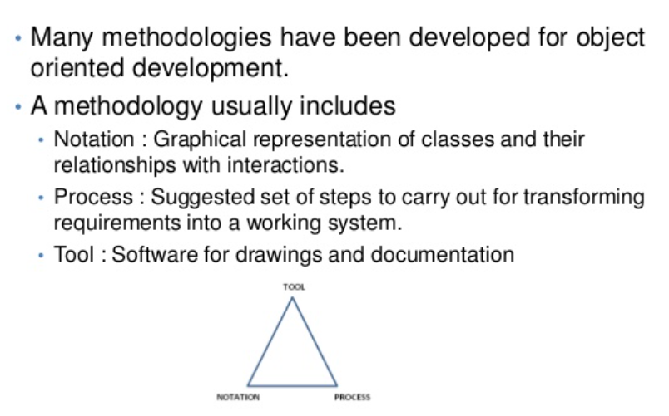
OBJECT ORIENTED METHODOLOGIES

Slide 45
ENCAPSULATION
Encapsulation is the process of binding both attributes and methods together within a class.
Through encapsulation, the internal details of a class can be hidden from outside.
It permits the elements of the class to be accessed from outside only through the interface provided by the class.
Encapsulation enables data hiding, hiding irrelevant information from the users of a class and exposing only the relevant details required by the user. We can expose our operations to the outside world and hide the details of what is needed to perform that operation.
Example from real world: Consider the smart phone you are using now. You are not worried about the internal operations of the smart phone. You only know and care about the operations or functions it exposes to you such as making call, sending SMS or using your apps.

Slide 46
INHERITANCE
Inheritance describes the relationship between two classes.
A class can get some of its characteristics from a parent class and then add unique features of its own.
Considering HumanBeing a class, which has properties like hands, legs, eyes etc, and functions like walk, talk, eat, see etc. Male and Female are also classes, but most of the properties and functions are included in HumanBeing, hence they can inherit everything from class HumanBeing using the concept of Inheritance.

Slide 47
POLYMORPHISM
Polymorphism means that one operation can be used for different purposes.
Poly means many and morph means form.
For instance, Java supports different kinds of polymorphism like overloading, overriding, parametric etc.
In overloading, the multiple methods having same name can appear in a class, but with different signature.
Overriding is defining a method in a subclass with the same name and type signature as a method in its superclass and the overriden method is called at runtime based on the object at runtime.

Slide 48
ABSTRACTION
Abstraction in OOP emphasizes what is important and what is not important at a particular level of detail.
Abstraction refers to the ability to make a class abstract at a level and define some of the behaviour at each level, relevant to the current perspective.
Abstraction allows the programmer to focus on few concepts at a time.
Java provides interfaces and abstract classes for describing abstract types.

Slide 49
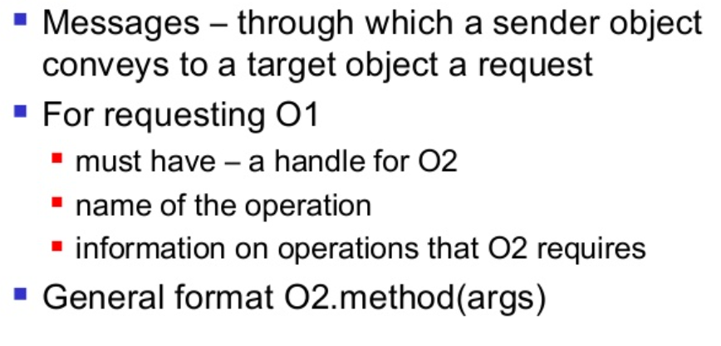
MESSAGES

Slide 50
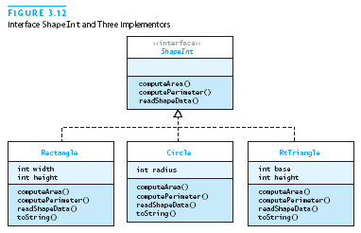
CLASS HIERARCHY

Slide 51
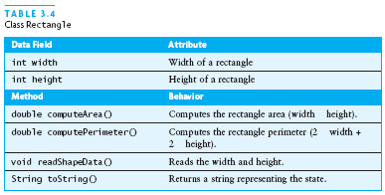

Slide 52
RELATIONSHIPS
Objects do not exist in isolation from one another
A relationship represents a connection among things
Class diagrams show classes and their relationships
Association
Aggregation
Instantiation
Using
Inheritance

Slide 53
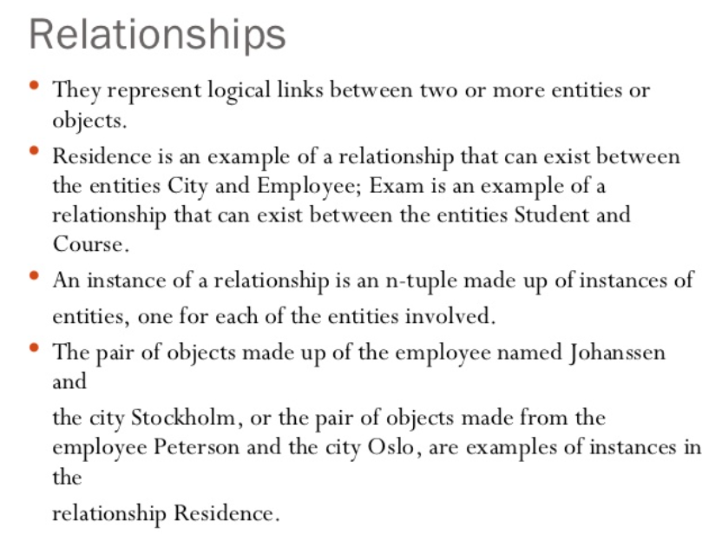

Slide 54
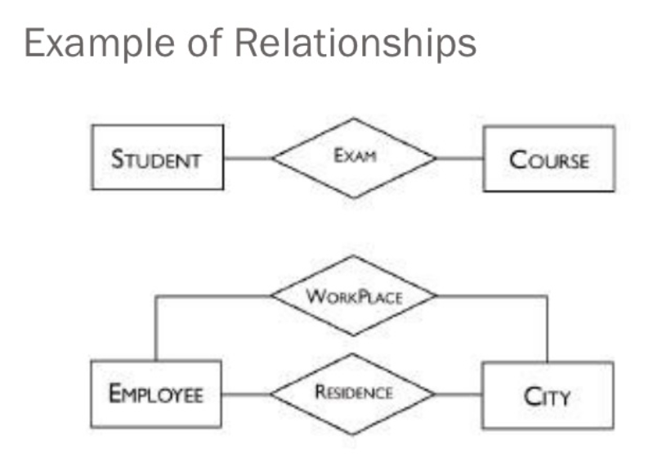

Slide 55
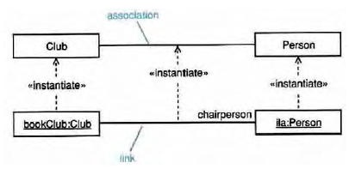
ASSOCIATIONS
Associations are semantic connections between classes.
If there is a link between two objects, there must be an association between the classes of those objects.
Links are instances of associations just as objects are instances of classes.

Slide 56
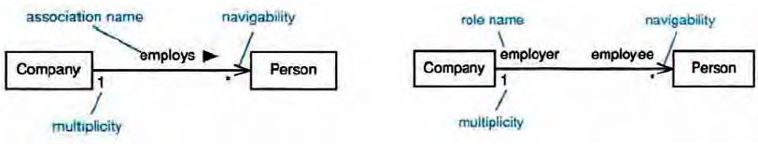
Associations may optionally have the following:
Association name
may be prefixed or post fixed with a small black arrowhead to indicate the direction in which the name should be read;
should be a verb or verb phrase;
Role names
on one or both association ends;
should be a noun or noun phrase describing the semantics of the role;
Multiplicity
The number of objects that can participate in an instantiated relation
Navigability
When objects need to know about other objects to call their operations

Slide 57
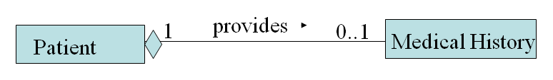
AGGREGATION
Specialized form of association in which a whole is related to its part(s)
Represented by a-part-of relationship
Denoted by placing a diamond nearest the class representing the aggregation

Slide 58
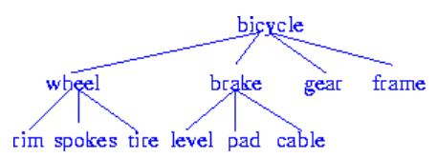
OBJECT CONTAINMENT
Objects that contain other objects are called complex or composite objects. There can be multiple levels of containment, forming a containment hierarchy among objects.
Example: A bicycle design database:

Slide 59
OBJECT CONTAINMENT
Containment allows data to be viewed at different granularities by different users.
E.g., wheel by wheel designer but bicycle by a sales person. The containment hierarchy is used to find all objects contained in a bicycle object.

Slide 60
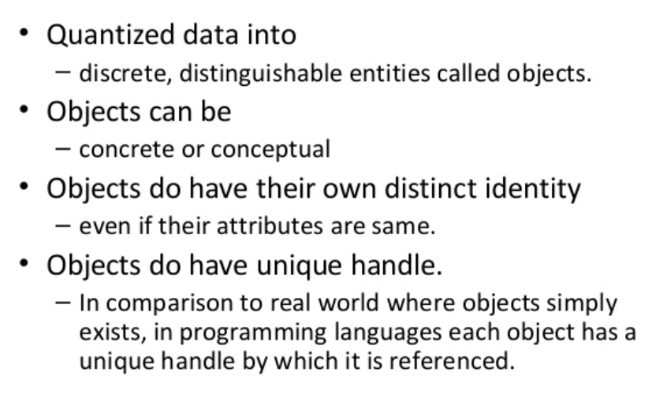
OBJECT IDENTITY
Object identity is a fundamental object orientation concept. With object identity, objects can contain or refer to other objects. Identity is a property of an object that distinguishes the object from all other objects in the application.

Slide 61
STATIC AND DYNAMIC BINDING
Determining which function has to be involved at compile time is called static binding.
Static binding optimized the calls. (Ex) function call. The process of determining at run time which functions to involve is termed dynamic binding
Dynamic binding occurs when polymorphic call is issued. It allows some method invocation decision to be deferred until the information is known.

Slide 62
STATIC AND DYNAMIC BINDING
Example:
Cut operation in a edit submenu. It pass the cut operation to any object on the desktop, each or which handles the message in its own way.

Slide 63
OBJECT PERSISTENCE
Objects have a lifetime.
They are explicitly created and can exist for a period of time that has been the duration of the process in which they were created.
A file or database can provide support for objects having a longer lifeline, longer than the duration of the process for which they are created.
This characteristic is called object persistence.

Slide 64
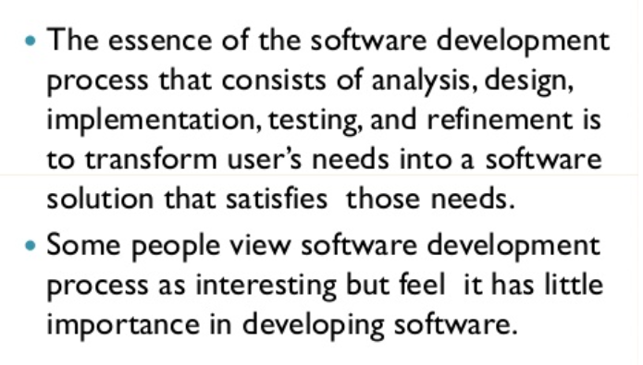
OBJECT-ORIENTED SYSTEM DEVELOPMENT LIFE CYCLE

Slide 65

OBJECT-ORIENTED SYSTEM DEVELOPMENT LIFE CYCLE
Software development
Analysis, design, implementation, testing & refinement to transform users’ need into software solution that satisfies those needs
Object-oriented approach
more rigorous process to do things right

Slide 66
OBJECT-ORIENTED SYSTEM DEVELOPMENT LIFE CYCLE
more time spent on gathering requirements, developing requirements model & analysis model, then turn into design model
need not see code until after 25% development time

Slide 67
OBJECT-ORIENTED SYSTEM DEVELOPMENT LIFE CYCLE
Process to change, refine, transform & add to existing product
transformation 1(analysis) - translates user’s need into system’s requirements & responsibilities. How they use system can give insight into requirements,
Eg: analyzing incentive payroll - capacity must be included in requirements
transformation 2 (design) - begins with problem statement, ends with detailed design that can be transformed into operational system
bulk of development activity, include definition on how to build software, its development, its testing, design description + program + testing material

Slide 68
OBJECT-ORIENTED SYSTEM DEVELOPMENT LIFE CYCLE
transformation 3 (implementation) - refines detailed design into system deployment that will satisfy user needs
takes account of equipment, procedures, resources, people, etc., - how to embed software product within its operational environment,
Eg: new compensation method program needs new form, gives new report.
Software process – transforming needs to software product

Slide 69


Waterfall Model – from ‘what’ to ‘use’

Slide 70
Why waterfall model fails
When there is uncertainty regarding what’s required or how it can be built
Assumes requirements are known before design begins
sometimes needs experience with product before requirements can be fully understood
Assumes requirements remain static over development cycle
product delivered meets delivery-time needs
Assumes sufficient design knowledge to build product
best for well-understood product
unable to cater software special properties or partially understood issues
doesn’t emphasize or encourage software reuse
Problem if environment changes
request changes in programs

Slide 71
Building high quality software
Goal is user satisfaction
how do we determine system is ready for delivery
is it now an operational system that satisfies user needs
is it correct and operating as we thought it should ?
Does it pass an evaluation process ?
Approaches to systems testing
Test according to
how it has been built
what it should do

Slide 72

Four Quality Measures
CORRESPONDENCE
measures how well delivered system matches needs of operational environment, as described in original requirements statement
VALIDATION
task of predicting correspondence (true correspondence only determined after system is in place)
CORRECTNESS
measures consistency of product requirements with respect to design specification
VERIFICATION
exercise of determining correctness (correctness objective => always possible to determine if product precisely satisfies requirements of specification)

Slide 73

Quality Measures

Slide 74


Slide 75

USE CASE TOOLS

Slide 76

USE CASE TOOLS

Slide 77

USE CASE TOOLS

Slide 78

USE CASE TOOLS

Slide 79

USE CASE TOOLS

Slide 80

USE CASE TOOLS

Slide 81

USE CASE TOOLS

Slide 82

FLOW CHARTS
https://slideplayer.com/slide/8691754/

Slide 83

USE CASE

Slide 84

OBJECT ORIENTED SYSTEM : A USE CASE DRIVEN APPROACH

Slide 85


Slide 86


Slide 87

OBJECT ORIENTED SOFTWARE DEVELOPMENT

Slide 88


Slide 89


Slide 90
OBJECT ORIENTED DESIGN
Goal : to design classes identified during analysis phase & user interface
Identify additional objects & classes that support implementation of requirements
Eg. add objects for user interface to system (data entry windows, browse windows)
Can be intertwined with analysis phase
Highly incremental, eg. can start with object-oriented analysis, model it, create object-oriented design, then do some more of each again & again, gradually refining & completing models of system
Activities & focus of oo analysis & oo design are intertwined, grown not built

Slide 91

OBJECT ORIENTED DESIGN

Slide 92

GUIDELINES IN OOD

Slide 93


Slide 94


Slide 95


Slide 96


Slide 97


Slide 98


Slide 99


Slide 100


Slide 101


Slide 102


